Slide 1
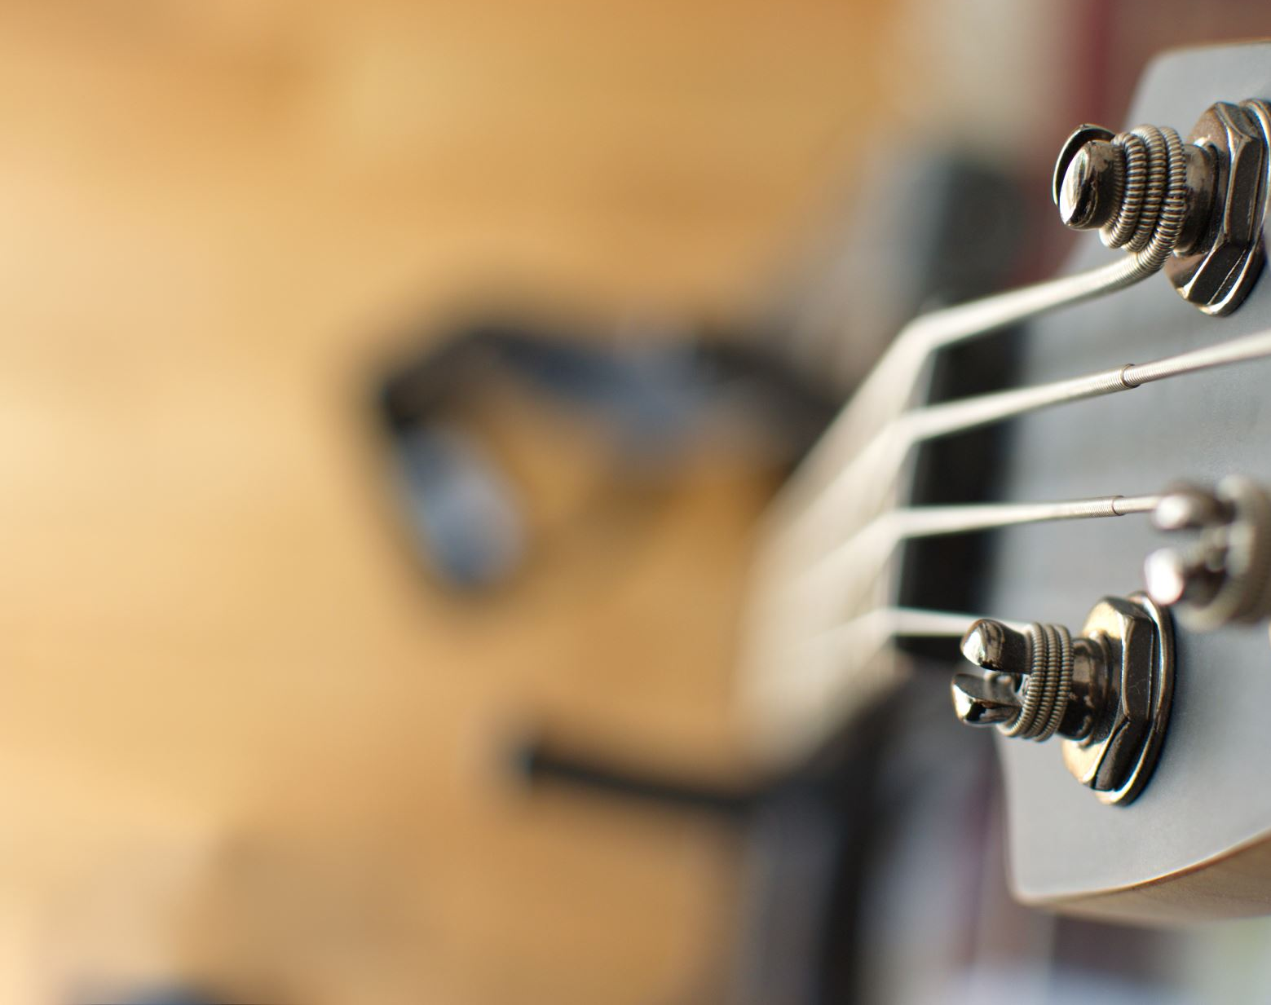
How to Virtually Recreate the Live Band Experience
By: Celine Edouard, Rosemary Geller, Stephanie Epeagba, and Steven Chisholm
Notes:
Hello thank you for being here today. My name is Stephanie and I'm here with Celine Rosemary and Steven and today we will present our Research on How to virtually Recreate the live Band Experience.

Slide 2
What We'll Cover
Q&A
The Problem Space
The Map of the Problem Space
The Pain Points
Notes:
In our presentation we will cover the following topics backed up by research:
The Problem Space
The Map of the Problem Space
The Pain Points
Q&A

Slide 3
The Problem

Slide 4
The Problem
Topic: The current virtual concert experience
What is problem?
There are no live concerts due to COVID-19
A virtual concert doesn't feel the same
Some are not willing to participate in virtual concerts
Notes:
For our project, we will be recreating seeing a band live, virtually. Our objective is to resemble an actual live concert to the best of our ability. To achieve this, my team and I conducted online research as well as user interviews to better understand our audience and their needs.
This topic is a problem because regular concert-goers are missing out on their live concert experiences due to COVID-19. When virtual concerts are held, users are not getting the same feeling they would during an in-person live performance. There are flaws in the way virtual concerts are being held, and our team will be addressing these problems in our project in order to create solutions.

Slide 5
The Map
Notes:
Next i will walk you through our map

Slide 6
The Current Map
Maps show how the users will move through our product
We have included all the major steps that include 4 different actors and one end goal.
Our Actors: The concert goers, the artist, the artist’s manager/music label, and the streaming service
Our end goal is: Experience seeing a concert/artist/band live virtually.
Notes:
Maps created for user research is a way for researchers to make a simple diagram of a complex problem, which allows our stakeholders to see how the users will move through our product as well as how they will use the product
We have included all of the major steps that we think our users will take, then proceeded to gather more information regarding the problem space through user interviews . We have touched on those pain points for our users as well, which we’ll review later in this presentation
Our actors are the concert goers, the artist, the artist’s manager and/or their music label, and the streaming service that is providing the concert service.
Our end goal is for our users to experience seeing a concert, or an artist or a band live, virtually.

Slide 7
The Current Map
Sees promotion for their fav artist
Download streaming service app
Make an account
Look for their fav artist
Look for concert of artist
Buy tickets for concert
Sign in to the concert
Watch the artist sing
Comment in the chat
Log off
Concert Goer
Virtually experience the feeling of seeing a band live
Artist
Manager
Streaming Service
Notes:
Our map tells a story of beginning, middle and end so our users understand what steps they will be taking within our prototype.
The artists, the manager and the streaming service all band together to promote the virtual concert to their fans. The actors being the artists, the manager, the streaming service and the concert goer all play a crucial part in the beginning of the map.
The concert goer then sees the promotion of their favorite artist and they proceed to download the streaming app and make an account. After their account is made, they’re going to look for the concert of their favorite artist and buy their ticket. After that, when the day of the virtual concert occurs, the concert goer will watch the artist perform as well as leave comments in the chat for the artist to see. Once the concert is over, the concert goer logs off, and they successfully have experienced a virtual concert live

Slide 8
The Pain Points

Slide 9
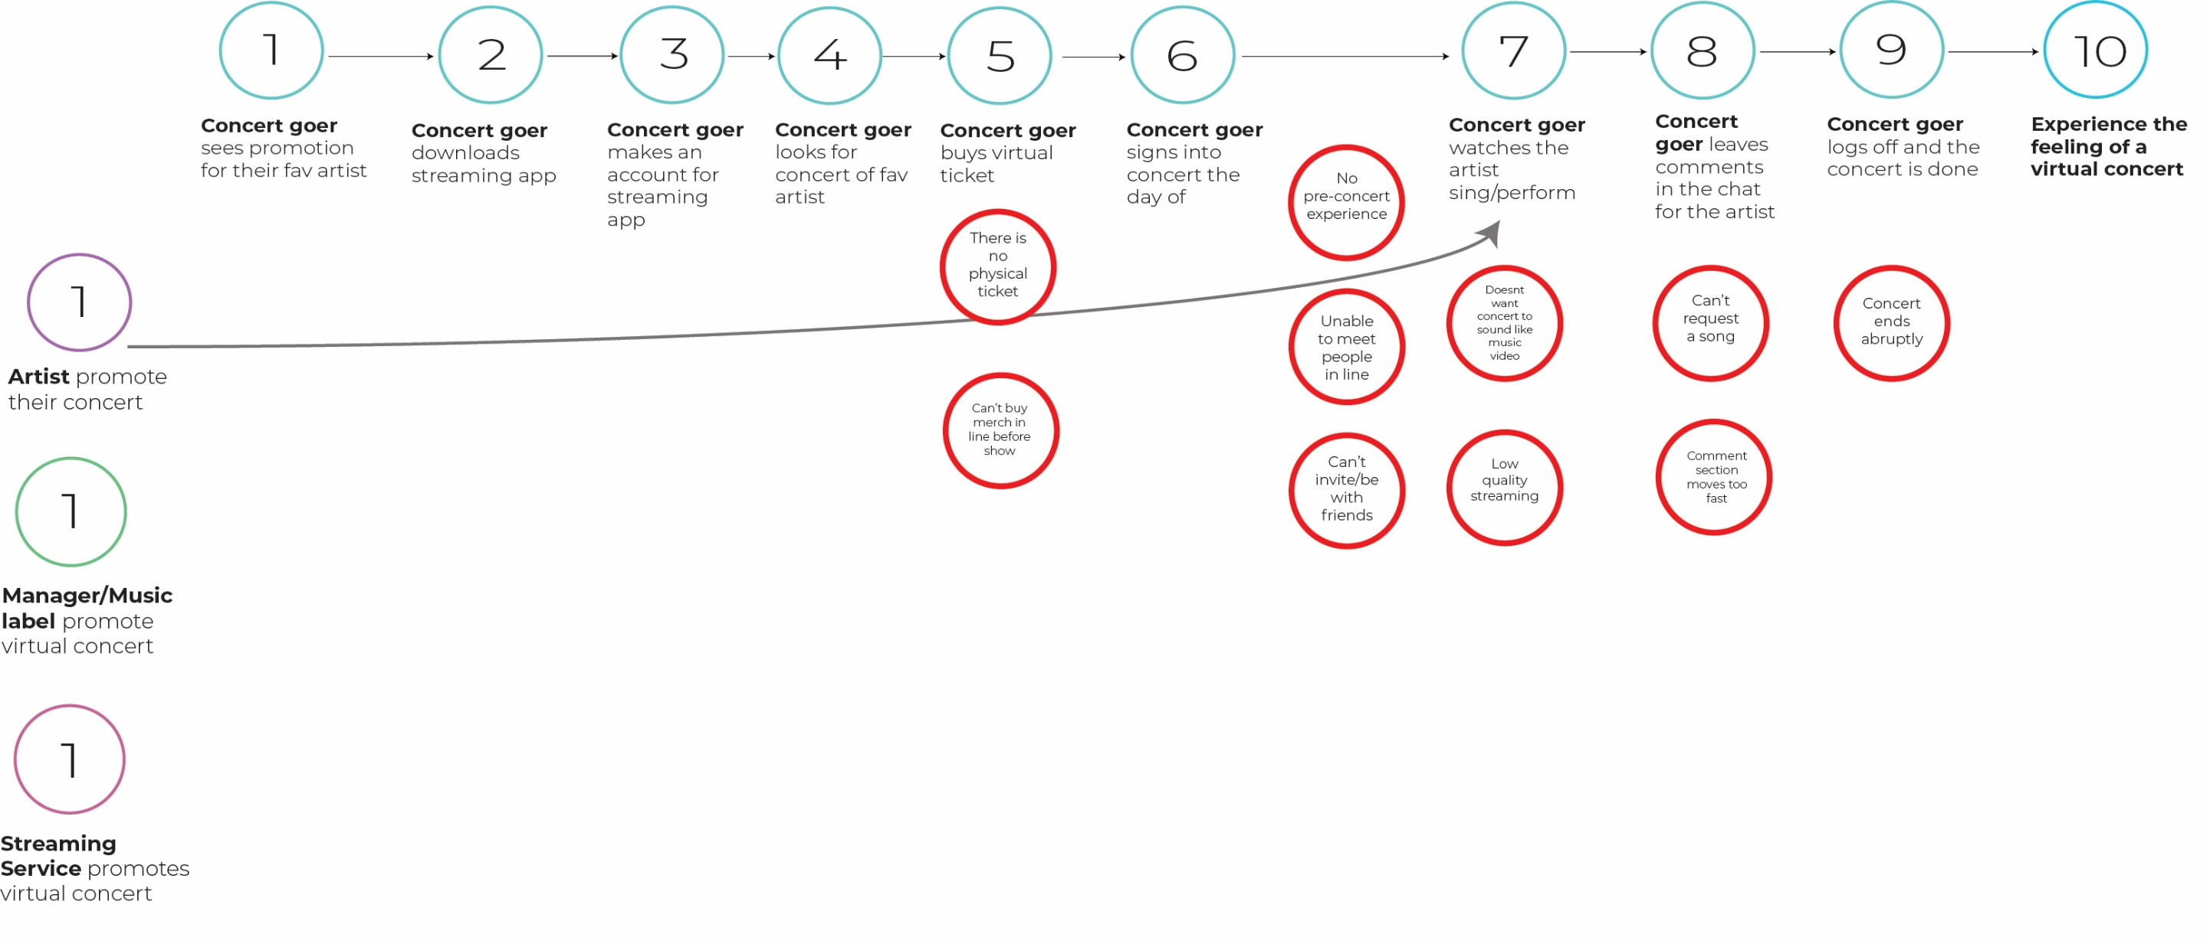
The Pain Points

Slide 10
Pain Points
Pre-Concert Experience
Fan and artist interaction

Slide 11
Pre-concert Experience
Problem
Before the pandemic, many concert goers would participate in activities before and after concerts that would enhance the overall concert experience. However, in analyzing our research data, we noticed that concert goers weren't participating in those same activities before attending virtual concerts.
Factors
No meeting up with friends
No meeting other concert goers/fans
Notes:
After establish the map a concert goer would take to attending a virtual concert, we discovered many pain points along the map that negatively effect the users end goal.
I will be touching on two of those pain points to provide insight in how concert goers view the current virtual concert experience.
Due to covid, concert goers had to stop participating in pre and post concert activities that helped enhance the overall concert experience. In turn, it has impacted the virtual concert experience for concert goers.
There are a couple of factors that impact the pre concert experience: Meeting up with friends and meeting new fans and concert goers.

Slide 12
The Current Map
Notes:
Our map tells a story of beginning, middle and end so our users understand what steps they will be taking within our prototype.
The artists, the manager and the streaming service all band together to promote the virtual concert to their fans. The actors being the artists, the manager, the streaming service and the concert goer all play a crucial part in the beginning of the map.
The concert goer then sees the promotion of their favorite artist and they proceed to download the streaming app and make an account. After their account is made, they’re going to look for the concert of their favorite artist and buy their ticket. After that, when the day of the virtual concert occurs, the concert goer will watch the artist perform as well as leave comments in the chat for the artist to see. Once the concert is over, the concert goer logs off, and they successfully have experienced a virtual concert live

Slide 13
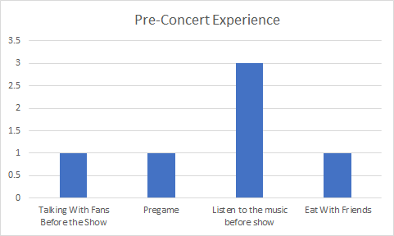
Notes:
All participants mentioned the importance of pre concert activates as well! Here are the highlighted activities as stated by the participants.
Listening to artist's music was the most common response!

Slide 14
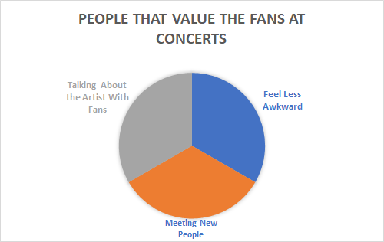
Notes:
100% of participants stated that one major factor about concert that they love was the fansand the value that they bring to the experience. Here is the break down of each key value as stated by participants.
Once we find out how to replicate these values virtually, we will be a step closer to recreate the full experience

Slide 15
Fan and Artist Interaction
Problem
Through our research we found that many concert goers want an appreciate an immersive and energizing concert experience. The virtual concert experience lacks in fully immersing concert goers and often times makes them feel uninterested and bored of virtual performances.
Factors
Can't request songs from the artist
Limited contact with fans
Live comment section is too fast
Virtual concerts are done alone
Notes:
Through our research we found that many concert goers want an appreciate an immersive and energizing concert experience. The virtual concert experience lacks in fully immersing concert goers and often times makes them feel uninterested and bored of virtual performances.

Slide 16
Notes:
{insert graph about artist fan interaction here}

Slide 17
Q & A
Thank You!
Notes:
Thank you for your time today. We will now take any questions that you have for us!

Slide 18
