Slide 1
“Seeing a Band Live” Report Out
By: Rosemary Geller, Celine Edouard, Steven Chisholm, and Stephanie Epeagba
Notes:
Hello thank you for being here today. My name is Stephanie and I'm here with Celine Rosemary and Steven and Rosemary and today we will present our Final report out on How to virtually Recreate the live Band Experience.

Slide 2
What We’ll Cover
Recap
HMW Statements
Art Museum
Prototype
Q&A
Notes:
In this presentation, we will start with a brief recap of our previous presentation to catch you up to speed,
We’ll discuss our How Might We statements and how we prioritized them,
The art museum stage or in otherwards, creating potential solution pathways
And finally, the solution in porotype format along with the user testing
We will wrap it up with a brief Q&A
I’m going to pass it on to Rosemary for the Recap!

Slide 3
The Recap
Notes:
First, we’ll recap our previous presentation where we covered the problem space, the map of the problem space, and the pain points

Slide 4
The Recap
Topic: The current virtual concert experience
What is problem?
There are no live concerts due to COVID-19
A virtual concert doesn't feel the same
Some are not willing to participate in virtual concerts
Notes:
Our topic is currently what a virtual concert experience would be like. And what the virtual concert experience is currently like. The problem is that because of covid-19, there are no live concerts and even some artists and bands that are not willing to participate in virtual concerts. Throughout our research, we as a team realized that there are many flaws in the virtual concert experience, and now we will present how we resolved those issues

Slide 5
The Recap
The Map
Sees promotion for their fav artist
Download streaming service app
Make an account
Look for their fav artist
Look for concert of artist
Buy tickets for concert
Sign into the concert
Watch the artist sing/perform
Comment in the chat
Log off
Concert Goer
Virtually experience the feeling of seeing a band live
Promote their concert
Artist
Manager
Streaming Service
Notes:
To better help us research our problem topic, we created a map to show how our users will move through our product. We wanted to touch on all of the major steps that our users will take during our research and applied this to our user testing. We had our users go through these major steps during our user tests for our prototype. Just to recap, our actors are the concert goers, the artist, the artist's manager or their music label, and the streaming service that is providing the concert service. Our end goal is for our users to experience seeing a concert, or an artist or a band live, virtually. Our map helped us and our users have a better idea of their end goal.

Slide 6
The Pain Points
Feels like YouTube video
Sees promotion for their fav artist
Download streaming service app
Make an account
Look for their fav artist
Look for concert of artist
Buy tickets for concert
Sign into the concert
Watch the artist sing/perform
Comment in the chat
Log off
Low quality
concert ending abruptly
Concert Goer
Artist
no pre-concert experience
No song request
Not a good experience
Promote their concert
Can’t buy merch in line before the show
Manager
No physical ticket
Can’t meet fans
Comments to fast
Streaming Service
Can’t meet friends
Notes:
During our user interviews, we came across a number of pain points that we wanted to highlight on during our designing. Two of our main pain points from our research were: the concept of the pre concert experience, and the artist’s interaction with their fans.
We wanted to take these pain points, and create a prototype that solves these issues for our users. Because people are now unable to go to a concert in person, during our user testing, we gathered the pain points that came up multiple times for our users when discussing the topic of going to a virtual concert experience. Some of the pain points were that there is no physical ticket and you cant buy merch in line before the show. Pain points when it comes to a virtual concert experience are that it feels like a youtube video, the quality may be low and the concert ends abruptly.

Slide 7
The How Might We Statements
Notes:
Once our pain points were Identified, our team then assessed those pain points and turned them into potential opportunities in the form of “How might We” statements. These “How might We’s became the foundation for our solution exploration.

Slide 8
The How Might We Statements
Ranked HMW statements based on users needs
High priority to Low priority
Removed repetitive statements
Notes:
With a myriad of HMW statements created, it was time for our to determine where they ranked on a spectrum from low priority to high priority based on our users needs. We first started by placing a HMW in the middle of the spectrum—one that was neither high or low priority-and then we ranked the rest accordingly. While ranking them, we had many HMW that we ended up abandoning, not because they weren’t good ones, but because some of them aligned with ones we had already ranked and others we felt weren’t necessary in ranking due to the findings from our research. The HMW with the highest priority was how might we have fans interact with the artist and this was because almost all interview participants stated they wanted more fan-artist interaction in a virtual concert. Our team felt satisfied with the rankings.

Slide 9
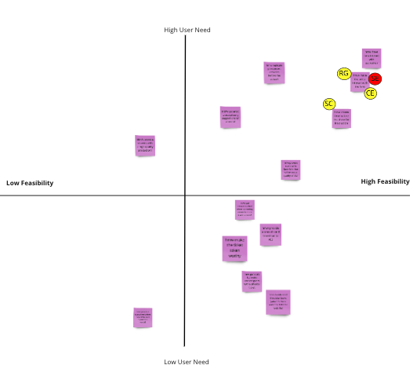
The How Might We Statements
Ranked HMW statements on based feasibility
“How might we have fans interact with the artist” won the vote!
Notes:
Our next task was to rank our HMW in order from least feasible to most feasible in regards to developing a prototype. We found that most of our HMW were feasible with the exception of a couple that were not capable of being developed and tested due to technological constraints. Each member of our team then casted a vote to determine which HMW we would focus on creating a solution for. There was a 3 to 1 vote on our Highest priority HMW—HMW have fans interact with the artist—our team was now ready to explore solutions.
In order to create the best solutions possible, our team participated in a brainstorming activity where we each sketched out a total of eight possible solutions for the chosen HMW and posted them on a board for the team to see. Once that was complete, we each chose one solution, from our individual lists of solutions, to expound on.

Slide 10
The Art Museum
Notes:
The next step in our project was to do an exercise called an art museum. At this stage, each group member created a solution sketch separately then uploaded our work to our Miro board.

Slide 11
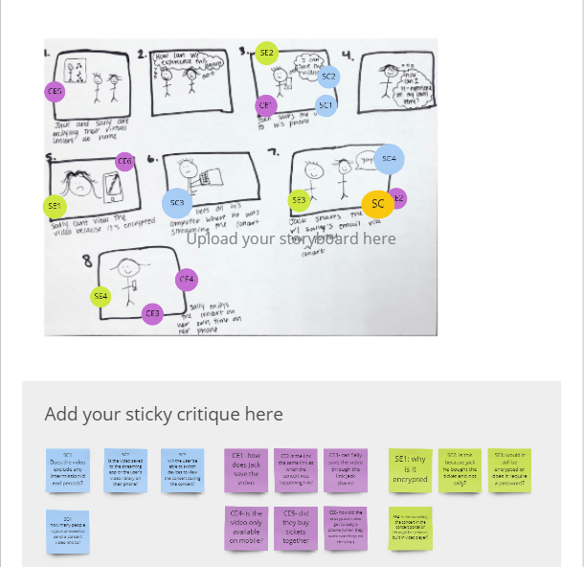
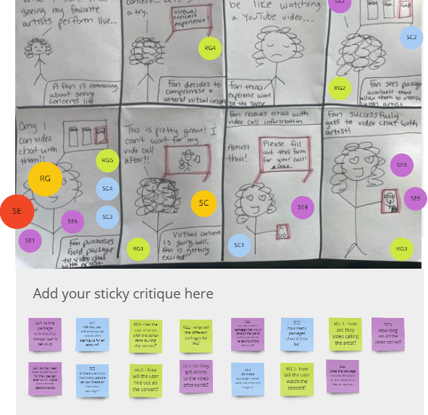
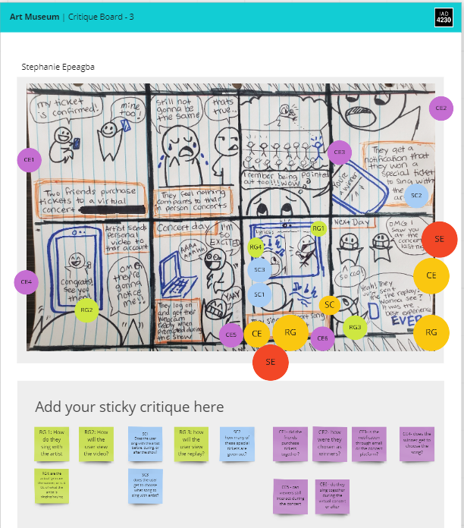
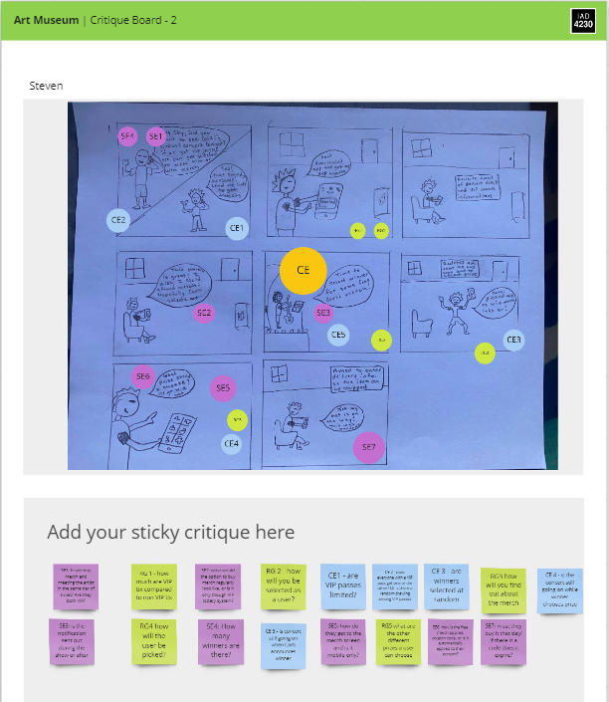
Steps:
Solution Sketch
Critique
Dot Vote
Final Vote
Final Choice:
Video call + sing along
Replay option
Notes:
Once our work was uploaded, we critiqued each member’s solution sketch. The way the critique worked, who ever’s story board was being critiqued, they would be silent.. Each member had dots with their initials on it and placed our respective dots on areas of the story board where we had questions. We repeated this dot voting process for each solution sketch. Once everyone’s work was critiqued, we did a final dot vote on which elements of all the solution sketches we wanted to move forward with.
Through our dot voting process, the paths we decided on were a video call with the artist and a sing along feature added to the virtual concert experience. We also agreed to include a replay option so fans will be able to relive the moment with their favorite artist. Our next step was to draft a justification for the paths we chose.

Slide 12
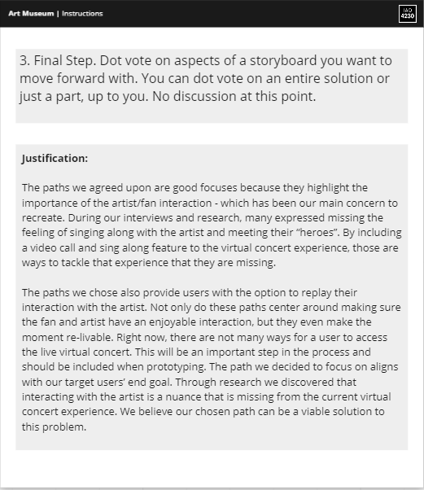
Justification:
Highlight artist/fan interaction
Users miss interacting with artist
Final path aligns with users' goals
Notes:
Our justification explained how and why we concluded that our final product should highlight the importance of the artist/fan interactions. This has been our main concern to recreate because during user interviews, users emphasized how they missed being able to interact with their favorite artist. The path we decided to focus on aligns with our users’ end goal. So we are confident that our chosen path will be a viable solution to this problem.

Slide 13
The Prototype

Slide 14
Notes:
Our prototype focused on the keypath of experiencing the sing along experience as well as the replay video feature. I will briefly walk through the Prototype!

Slide 15
The Testing
Notes:
After 5 user tests we processed our data and noticed many trends in our findings. I will now break down the user testing results and general feedback

Slide 16
The Results
Notes:
This shows the number of people that passed and failed he question, green being pass, and red being failed. Most people passed eveything but one question. Changing the concert view. Everyone failed that one.

Slide 17
General Feedback
Use a better icon for concert view
Confusion on the "End Call" button
Notes:
Of the 5 users we interviewed
Order of the buttons on the screen could be changed to
Volume
Mute
Screenshot
Settings
End Call

Slide 18
General Feedback
All would really like this feature
"A great way for interaction"
"Neat and creative"
"Has all the basics" + "straight forward"
"Exciting" + "Cool"
Notes:
Over all people had a good experience with the prototype.

Slide 19
Q&A
Thank You
Notes:
Thanks~

